Slide 1
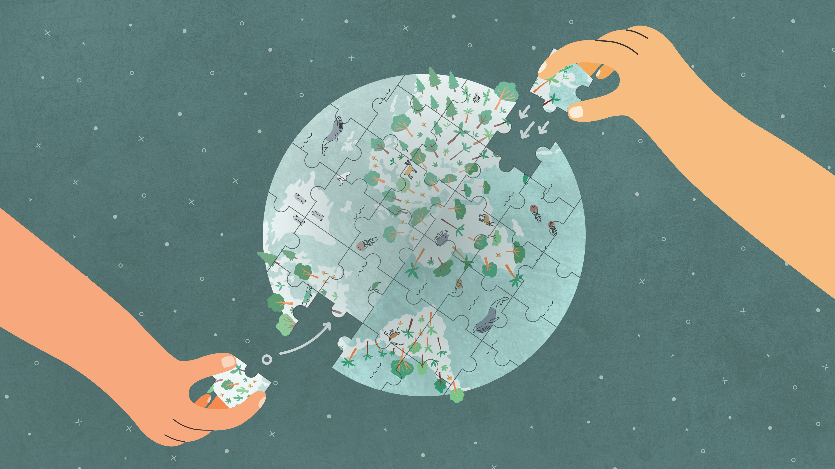

Climate change
gbif.org/climate

Slide 2
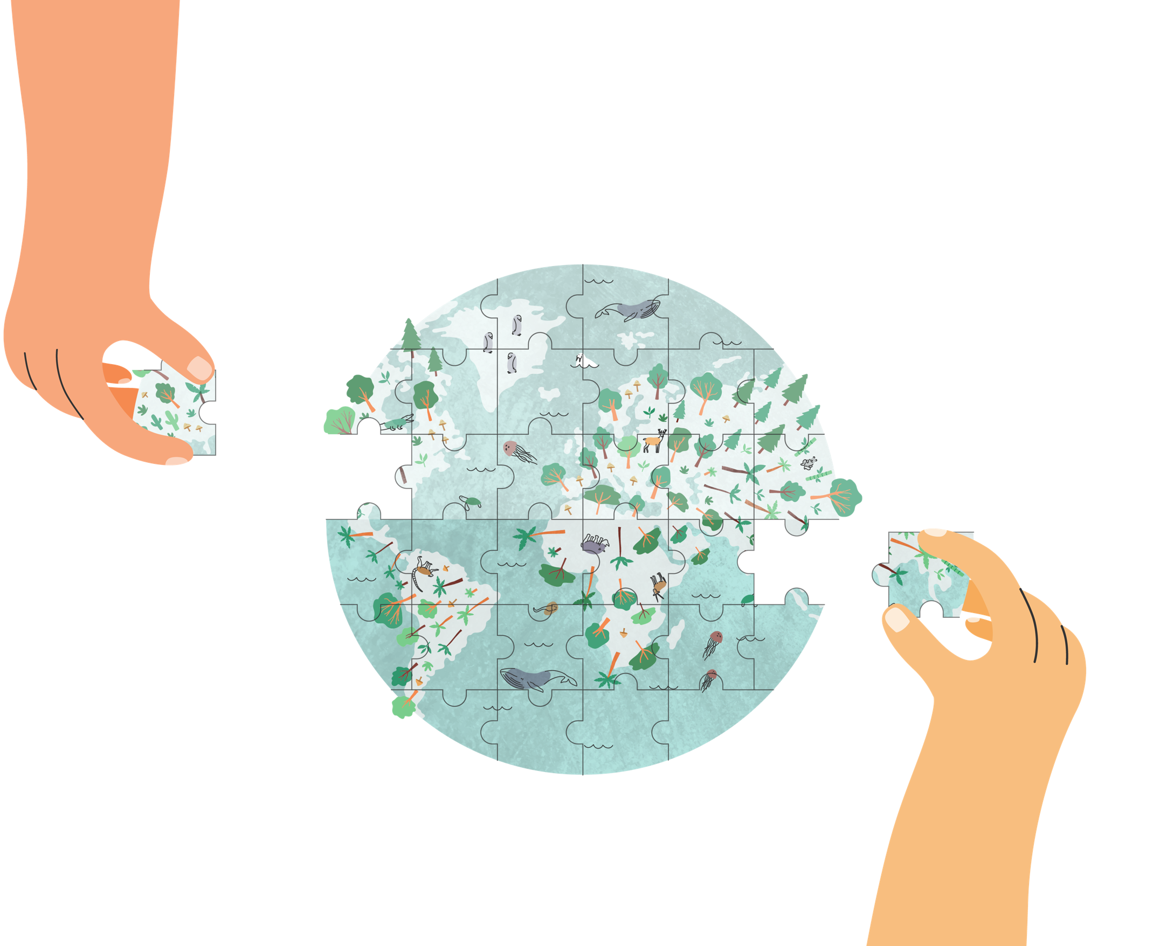
Climate change
Notes:
Text from postcard:
Biodiversity data from the GBIF network is an essential input for understanding the intensifying impacts of climate change and for creating adaptation and protection strategies for life on Earth.

Slide 3
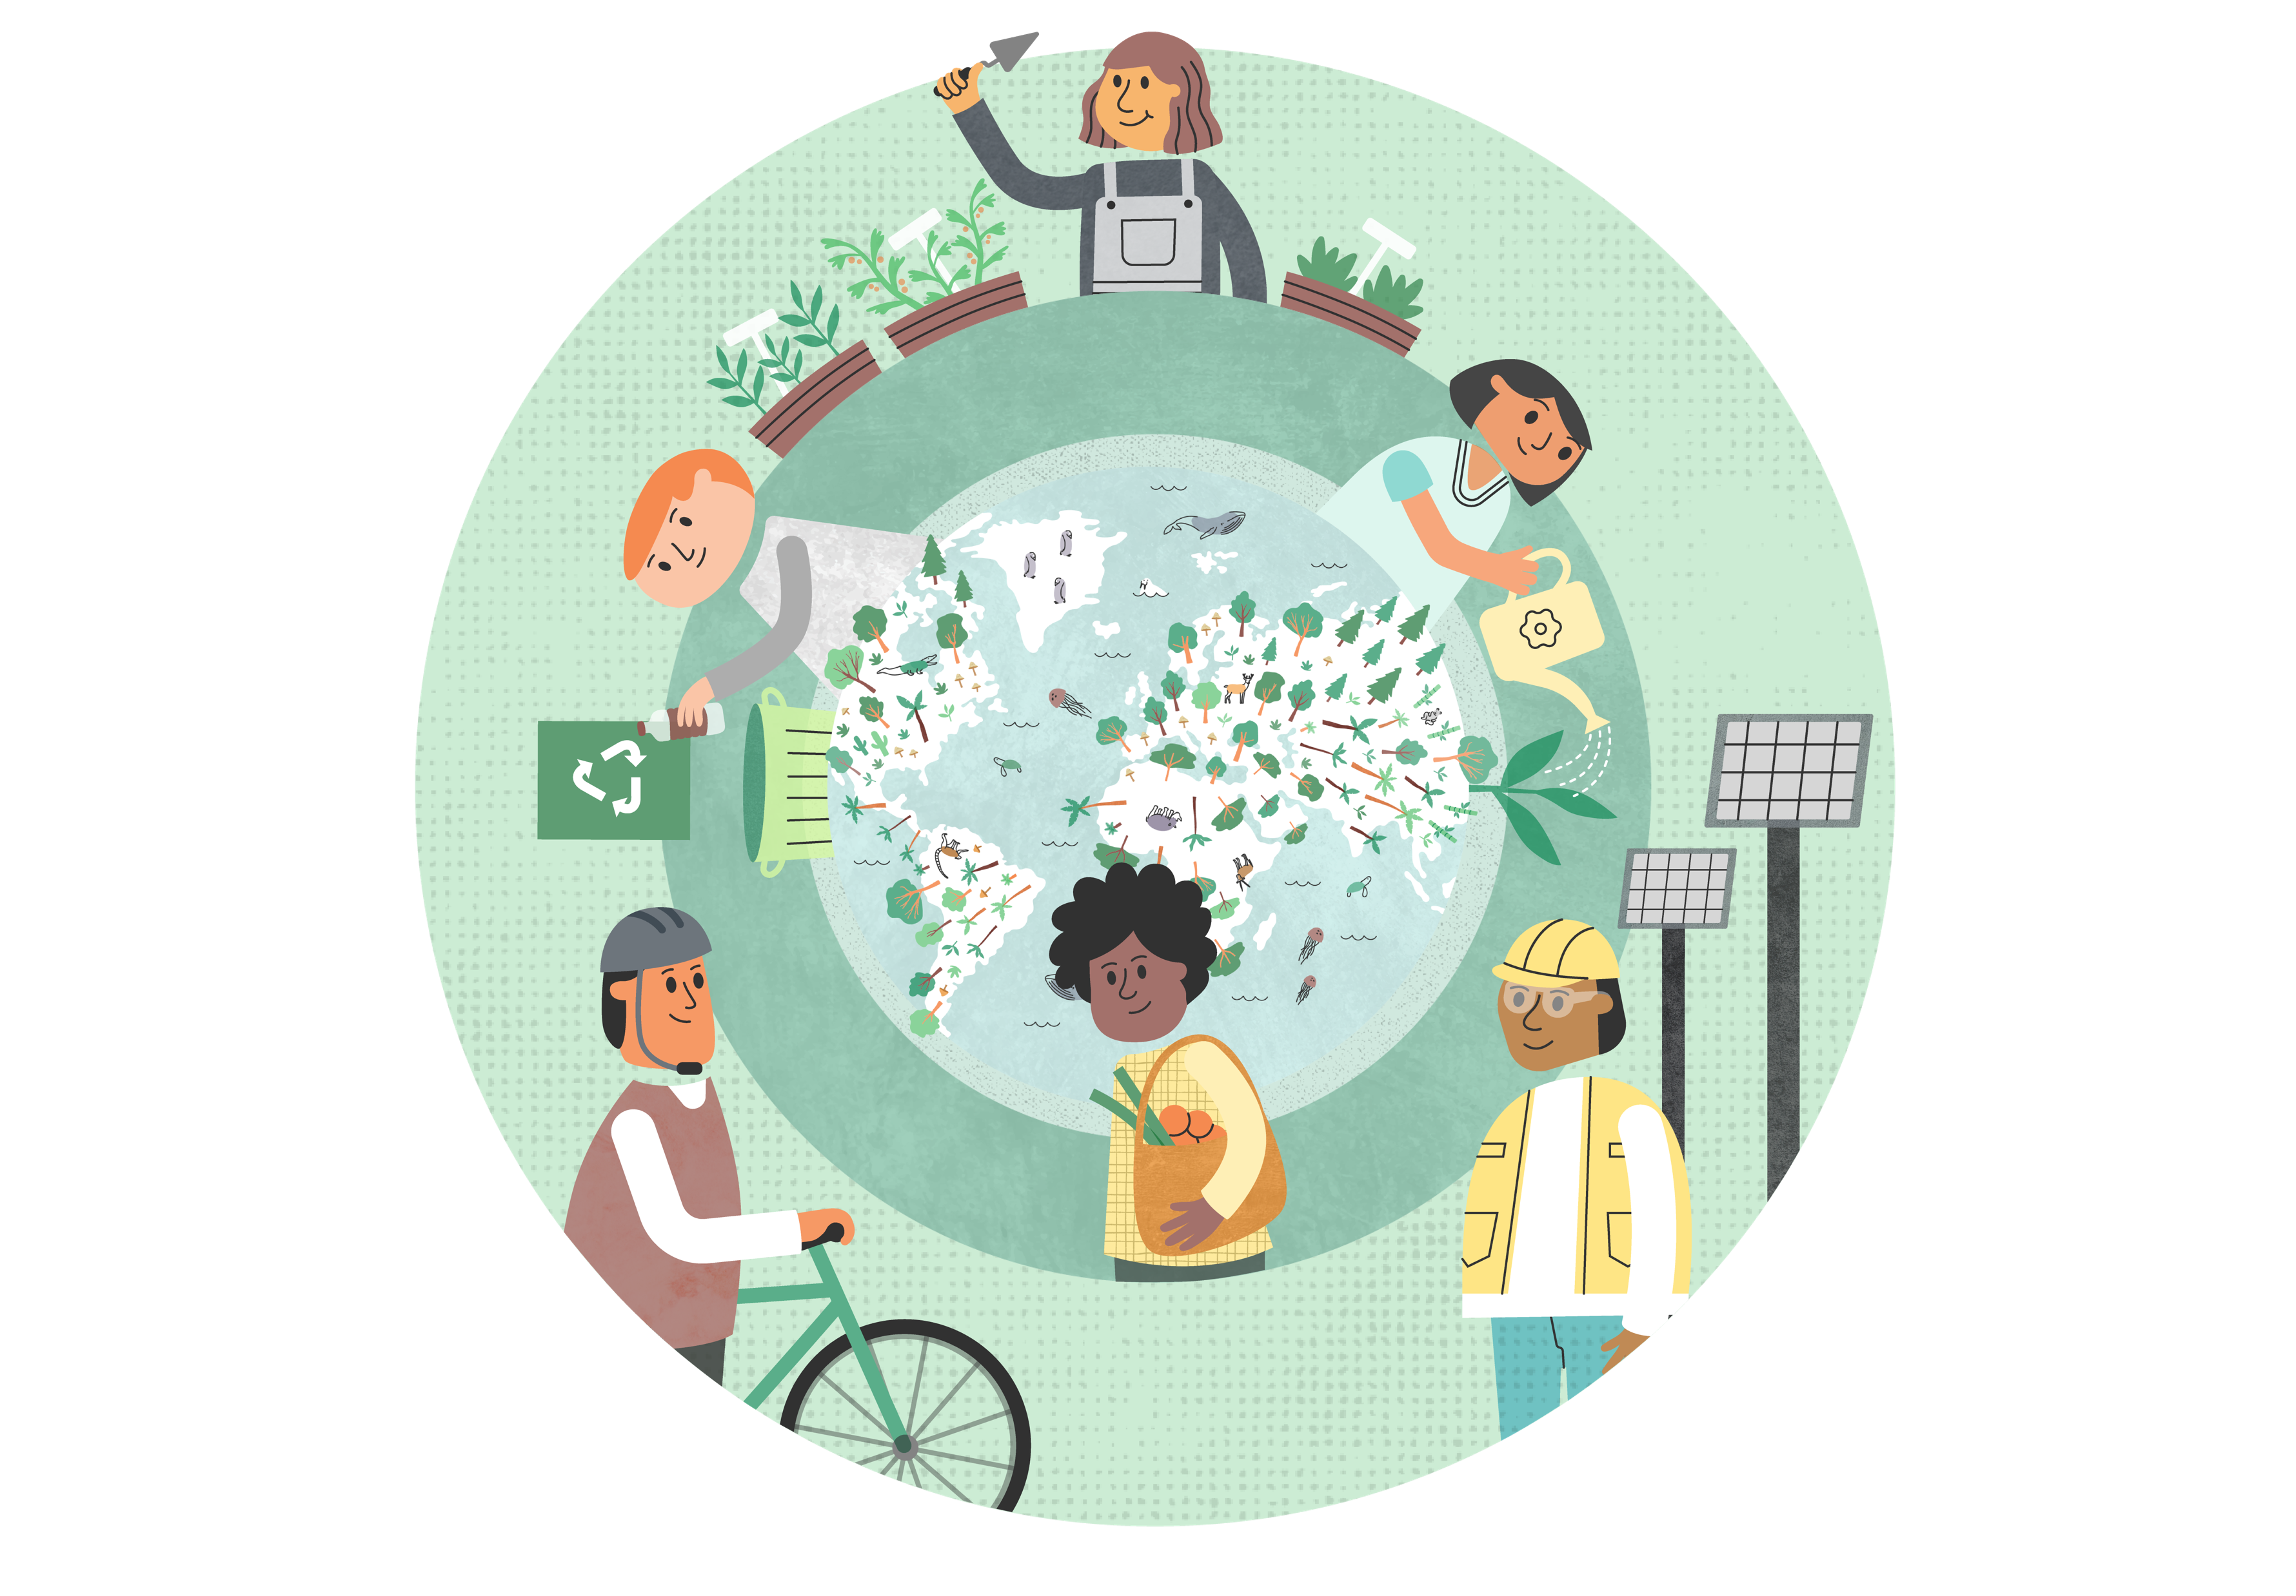
Climate change
GBIF mediated-data is an essential input for understanding the impacts of climate change on biodiversity, including setting priorities and creating protection strategies
Notes:
Notes

Slide 4
Climate change
How might we expect the distribution of the world’s species to shift as a result of climate change? What impact will these changes have on landscapes, oceans and ecological relationships?
Researchers investigating climate impacts regularly turn to GBIF for data about where species occurred in the past and where they are now. Combining it with key climatic and environmental layers, they produce the models that reveal the interactions between climate change and biodiversity and identify the species at greatest risk from ongoing and future disruptions.

Slide 5
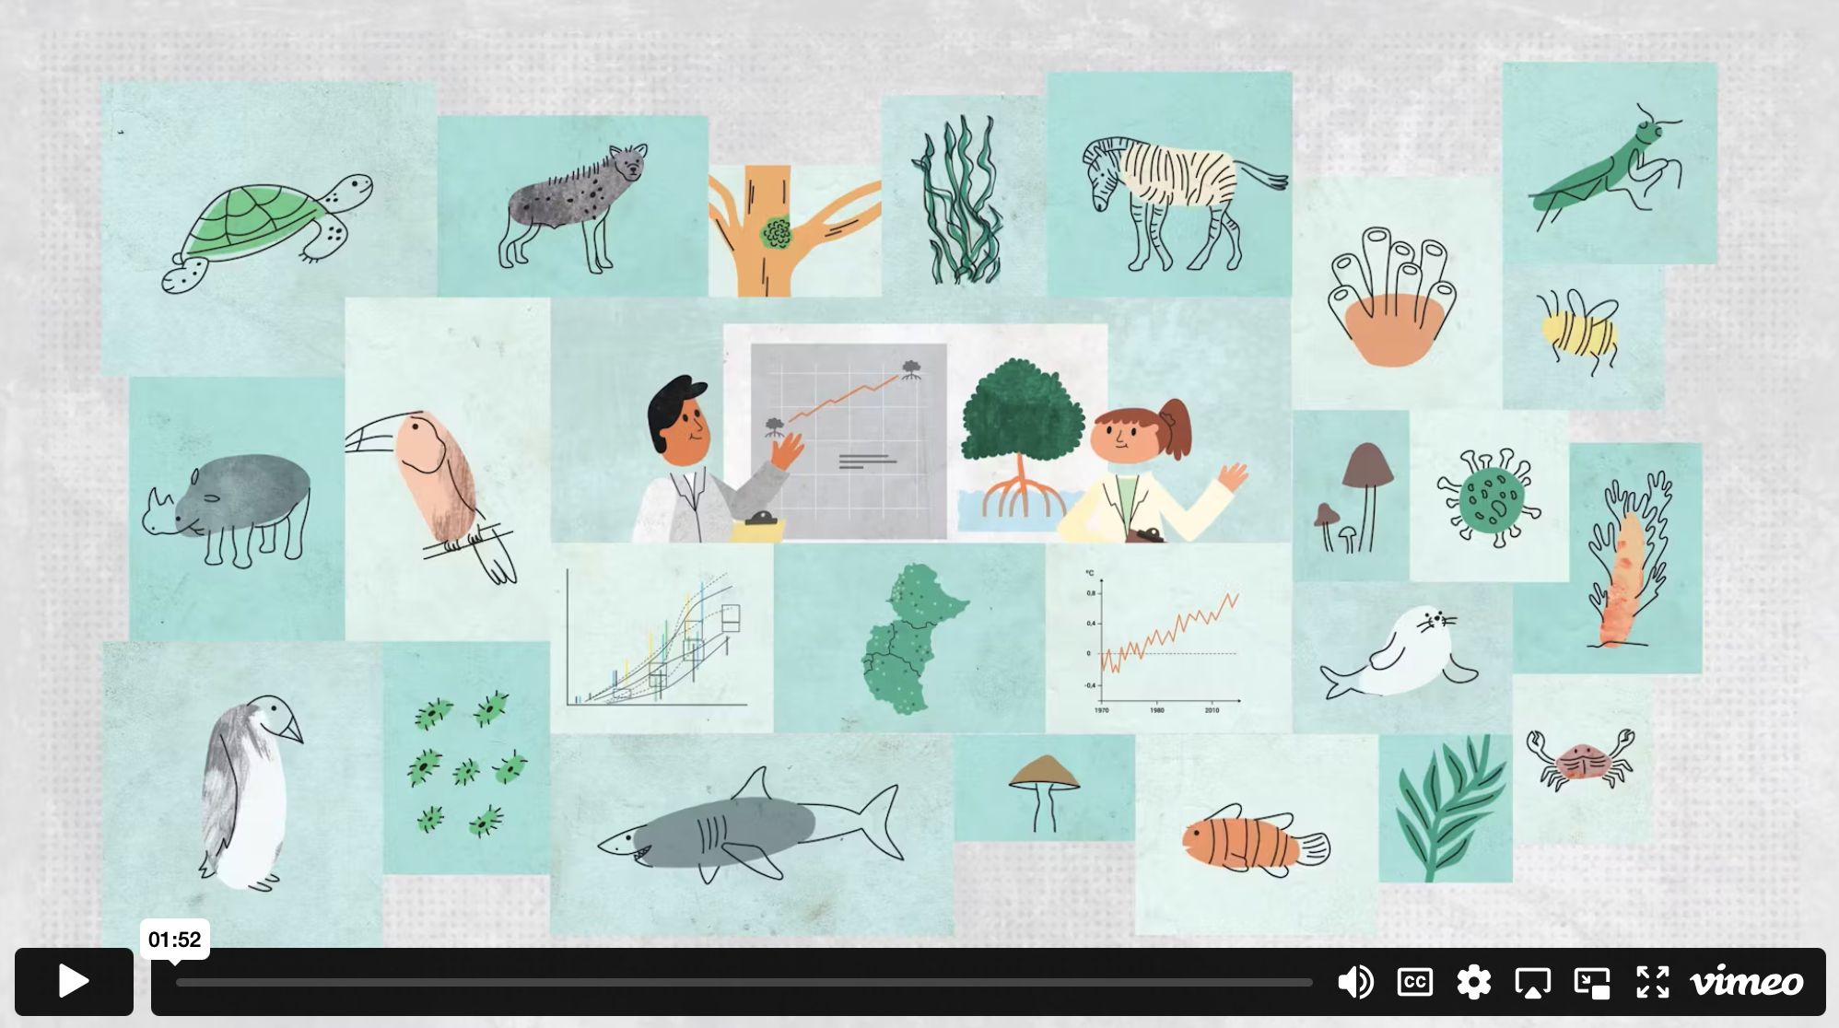
GBIF & health - Video

Slide 6
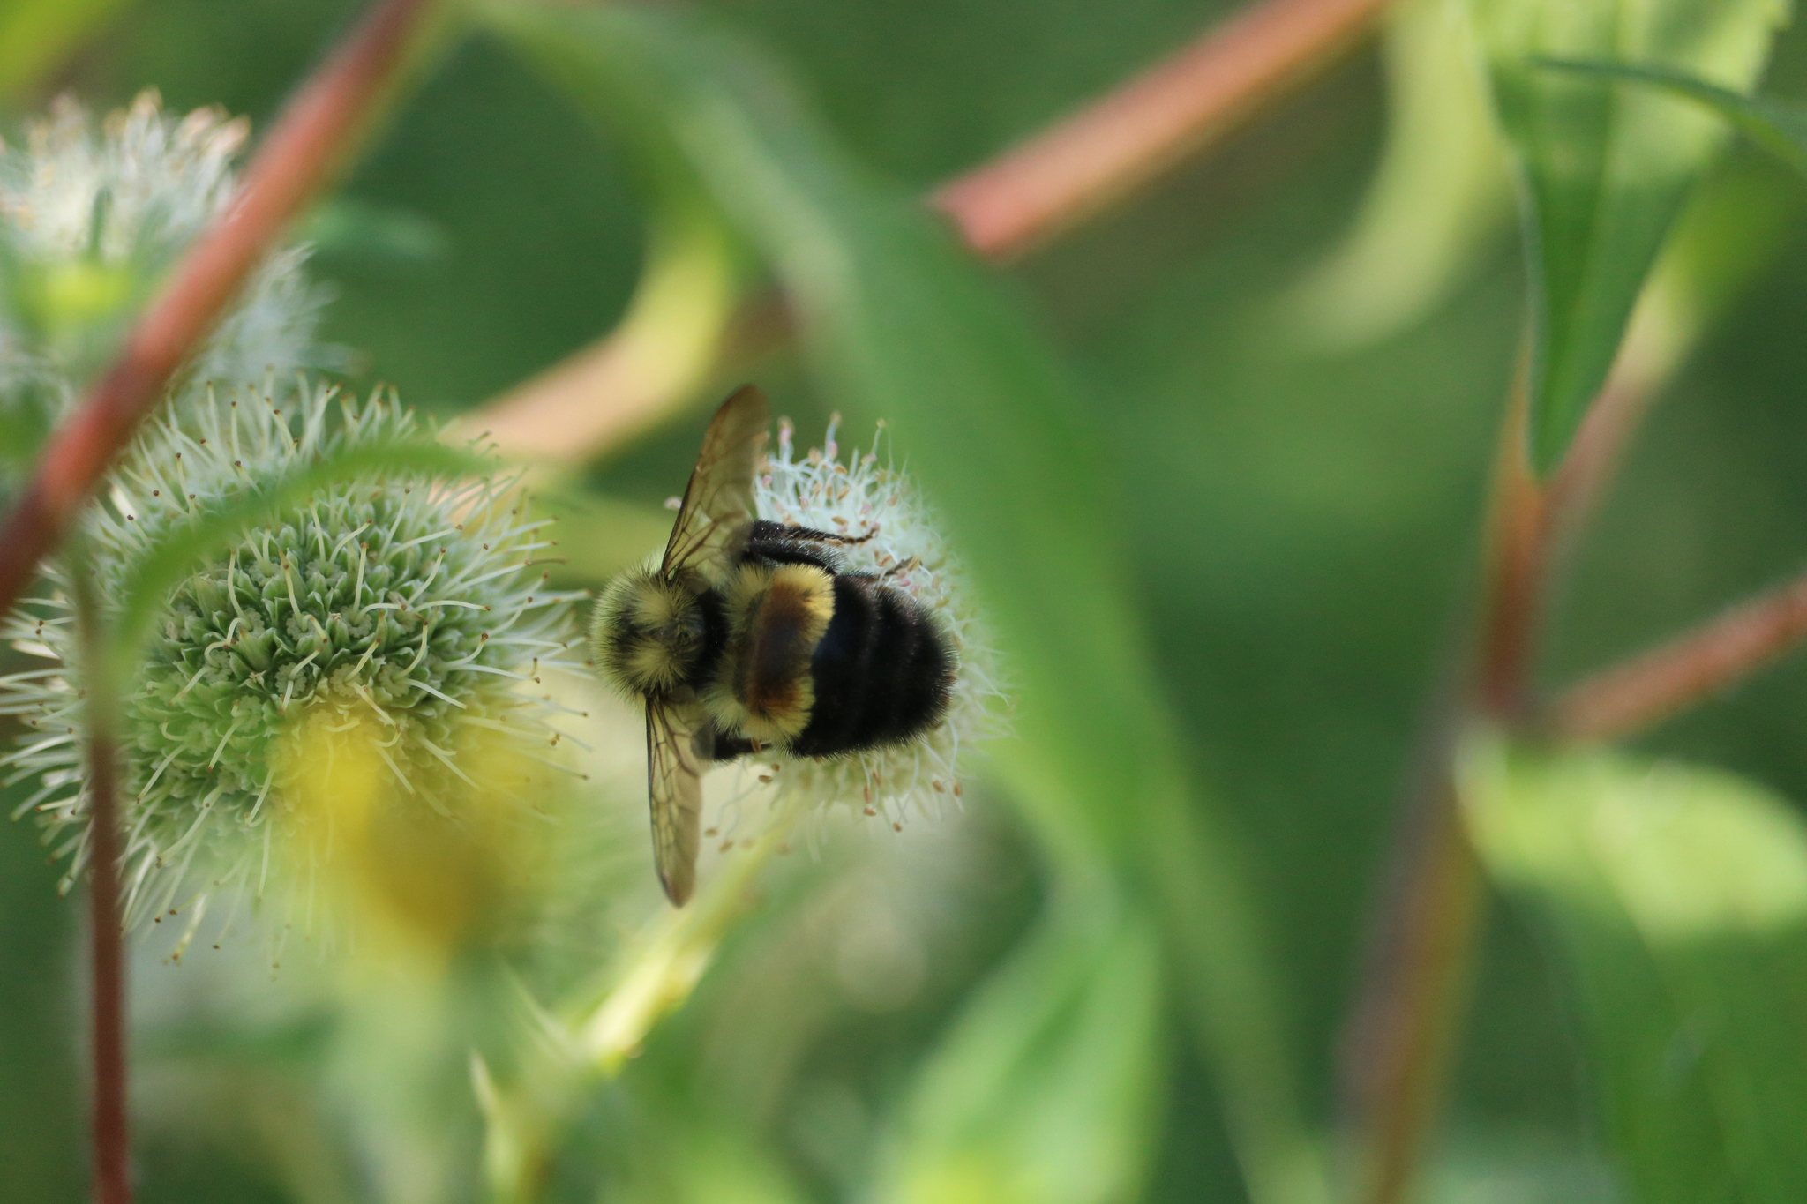
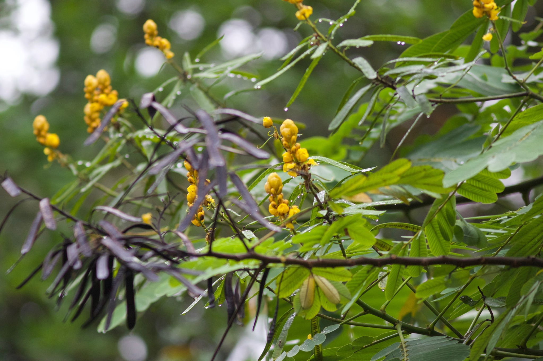
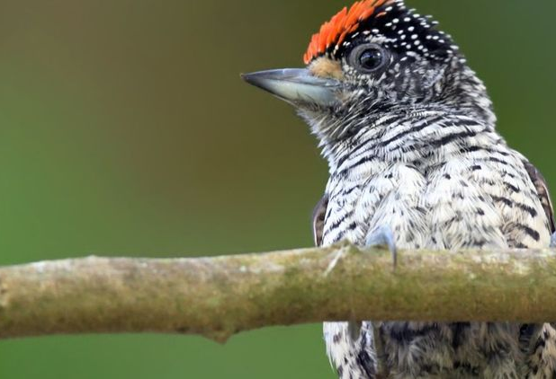

Climate-related policy uses of GBIF-mediated data
Data from GBIF network bolsters biodiversity findings of IPCC special report
Assessing the capacity of ecosystems to retain biological diversity under climate change
Translating international conservation commitments into national planning action
Effects of protected areas on global biodiversity
Notes:
Notes

Slide 7
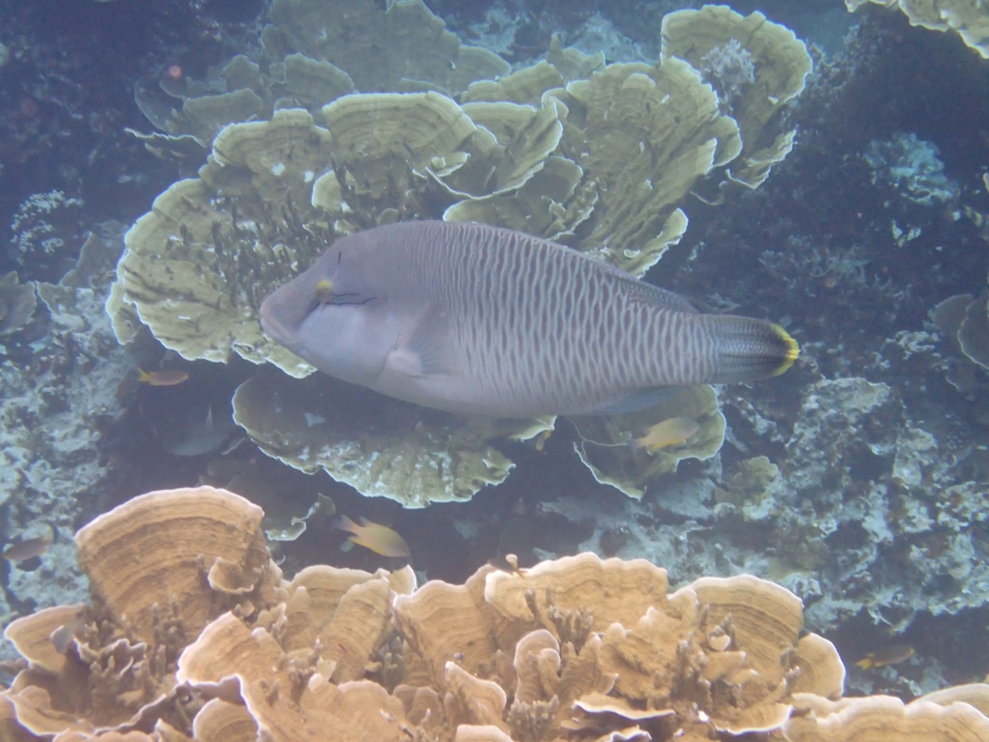
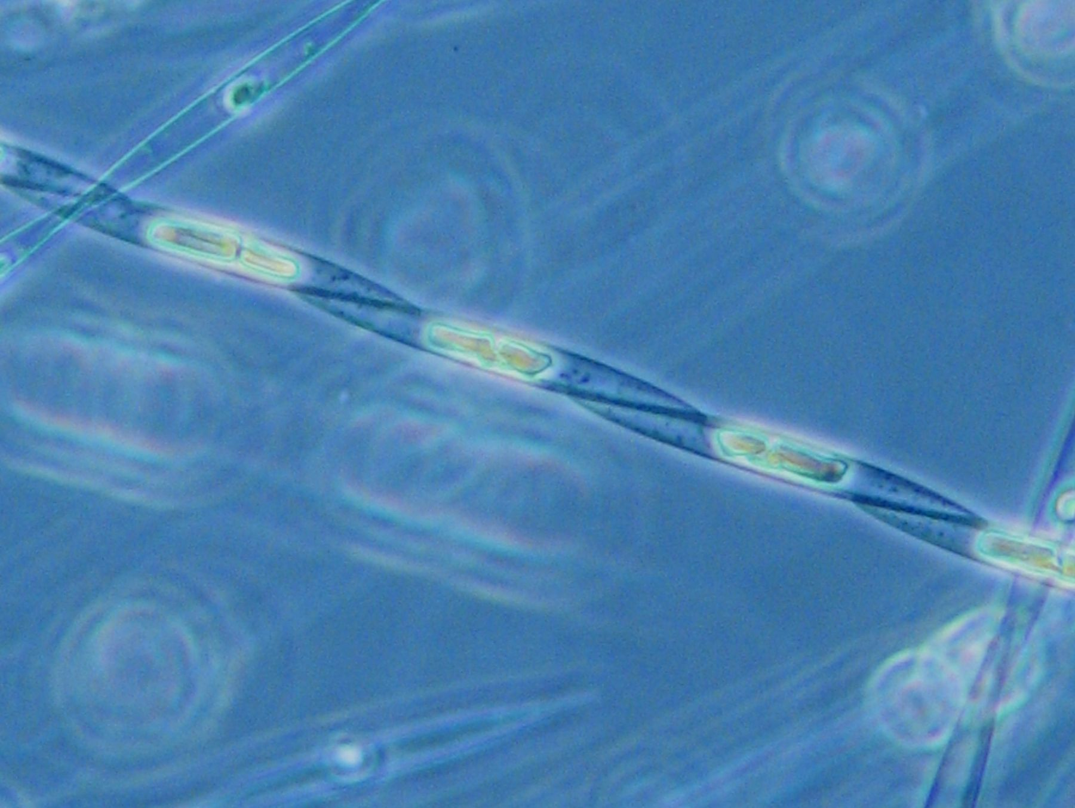
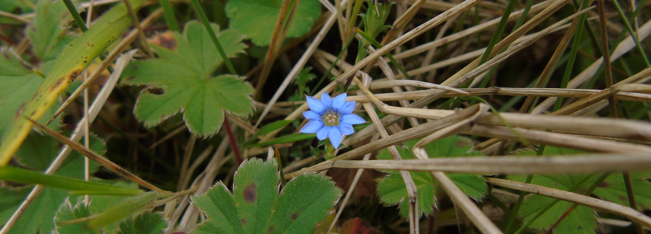
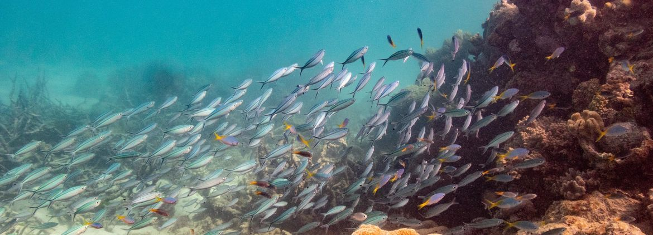
Recent data uses in climate change
Global decline in capacity of coral reefs to provide ecosystem services
Global warming reshuffling marine plankton communities
Climate change threatening medicinal plants of Indonesia
If corals go extinct, half the world's tropical fish may follow
Notes:
Notes

Slide 8
Climate
Learn more!

